Slide 1
How to record jMeter script via Badboy
How to use it?

Slide 2
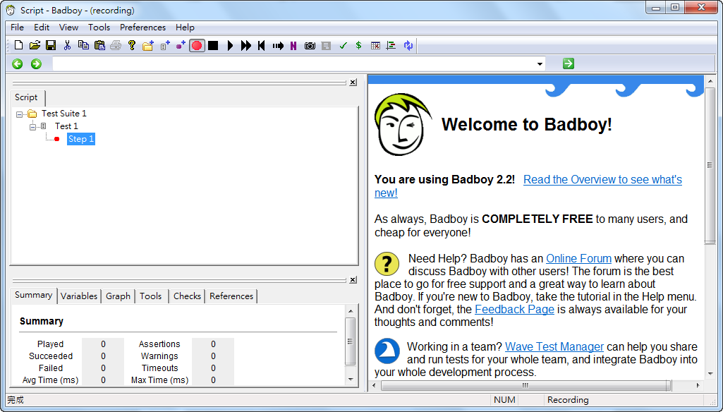
Badboy
http://www.badboy.com.au/

Slide 3
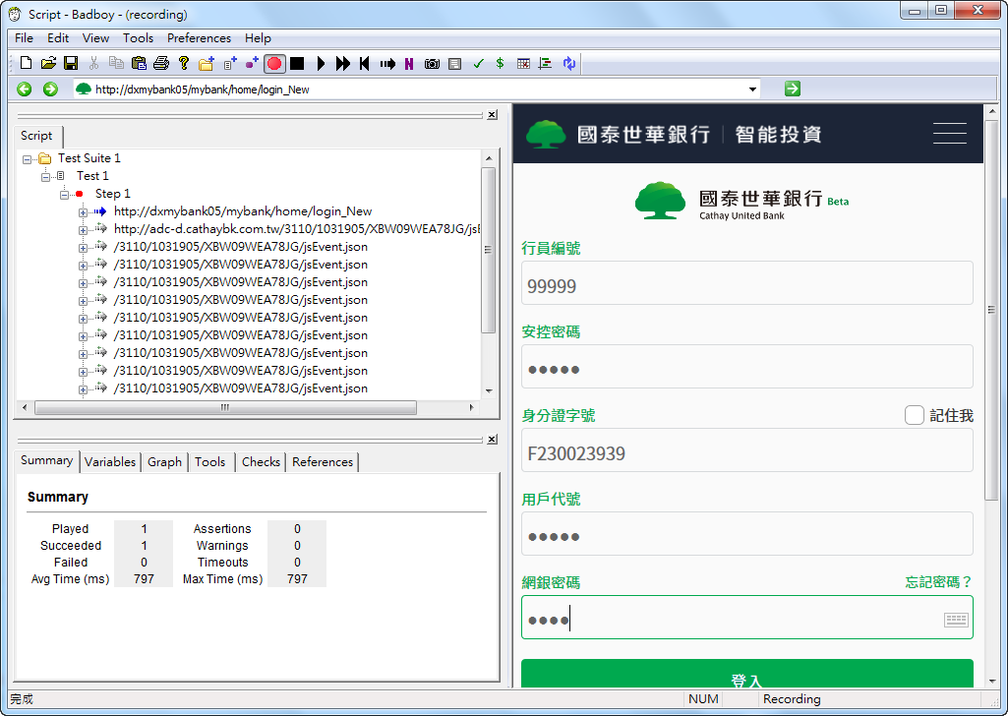
Badboy
目標主機URL
目標主機畫面
Http Request

Slide 4
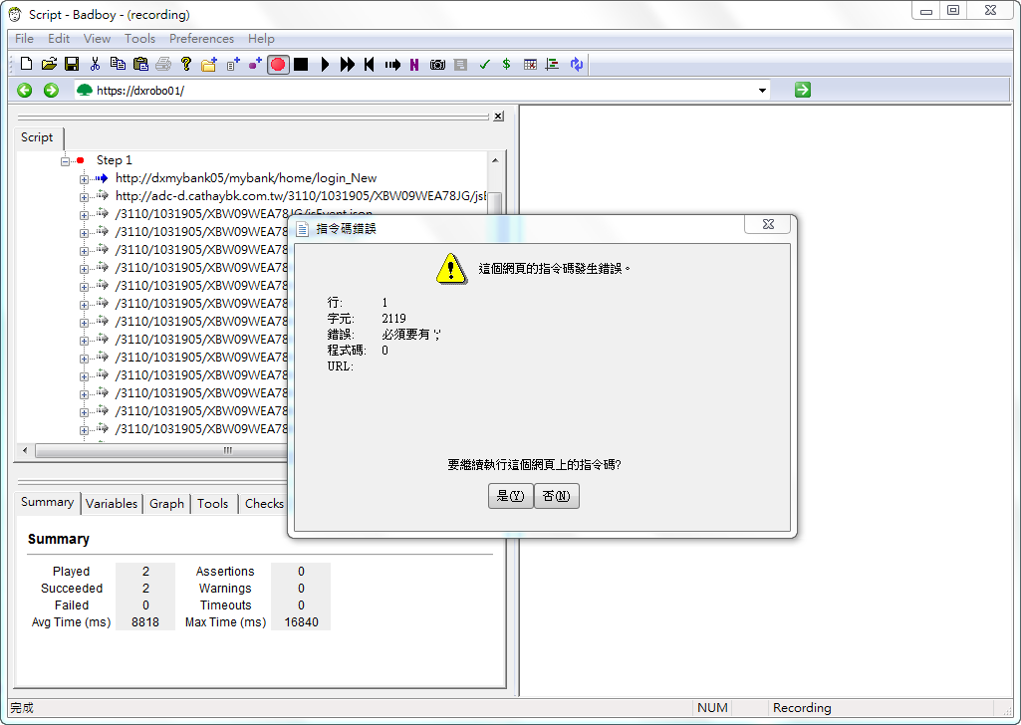
Badboy

Slide 5
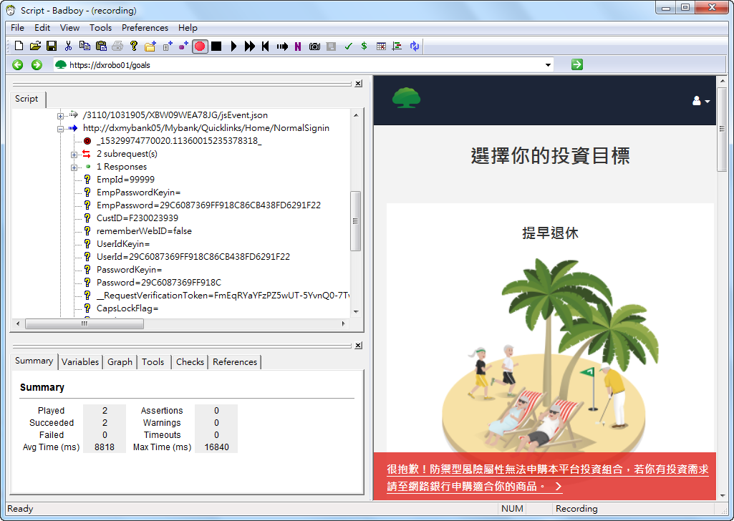
Badboy
Request Parameters

Slide 6
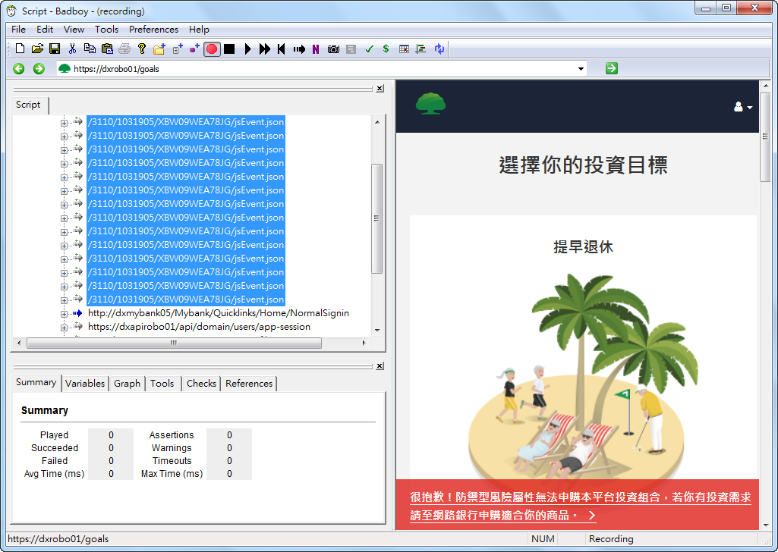
Badboy
移除不需要的item

Slide 7
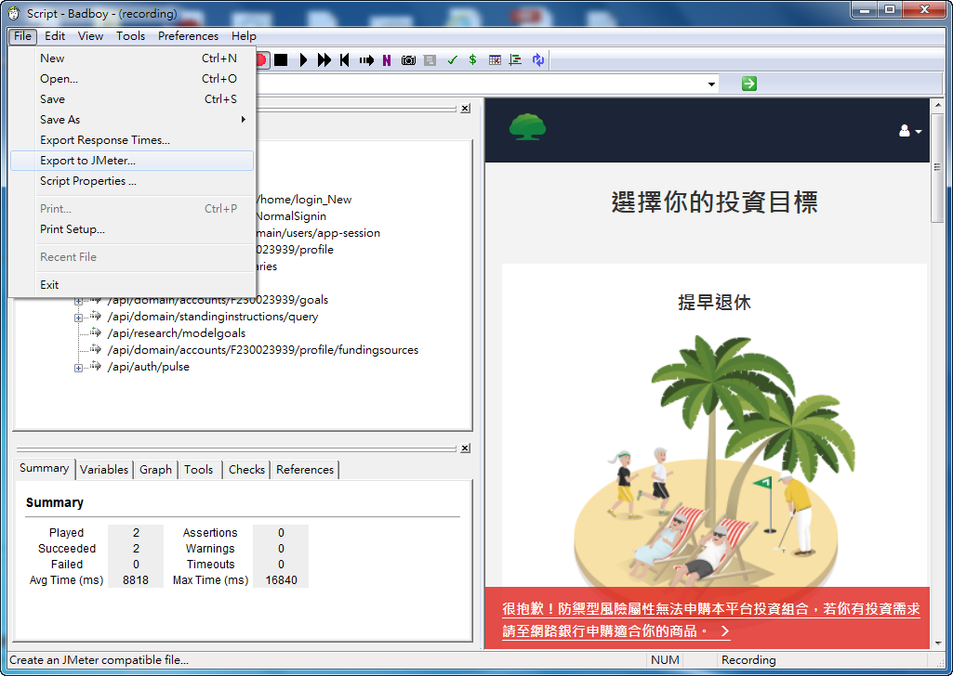
Badboy
匯出成jmeter script

Slide 8
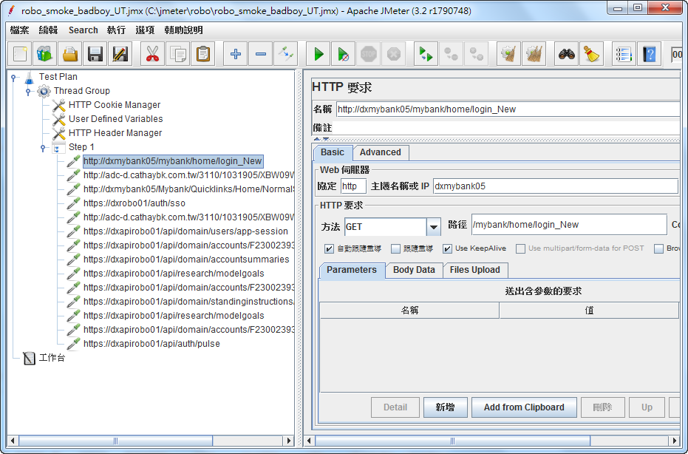
Badboy – jmeter
Jmeter開啓script修改

Slide 9
Thank you for listening

